Slide 1
CENTRAL BOARD OF EXCISE & CUSTOMS
Central Revenue Control Laboratory (CRCL) Module
January 15, 2015

Slide 2
CRCL Module
Components
A. Directory Management at Nation Level: Directories of CRCL Labs and other authorized labs
managed at national level. The directories assigned to officers having role of ‘DIRMGR’ and ‘DIROFF’.
Officers to enter Lab particulars and map Labs to a Customs Location. Officers also responsible for
lab-wise items that can be tested, both positive and negative list (Lab-wise and CTH-wise directory)
Local Systems Manager (LSM): LSM responsible for registration of local labs by assigning Lab code; assign roles – ‘CLAB’ and ‘CLABADM’ to officials of Labs associated with the Customs House.
(a) Lab Administrator (CLABADM): Officer having Role of CLABADM will give privileges to Officers for
marking, report entry and verification.
(b) CLAB Role: Assigned to officers who can have privilege to enter reports, marking sample for testing
and verification of report after entry of report by entry officer.
BE Processing: While appraising Bill of Entry (BE), the Appraising Officer (AO), if desires to draw a sample of the item for test purpose, will have to close the Appraising Option and Select Option – Sample Test Entry from main menu and enter test requirements of items and select Lab where it shall be forwarded.

Slide 3
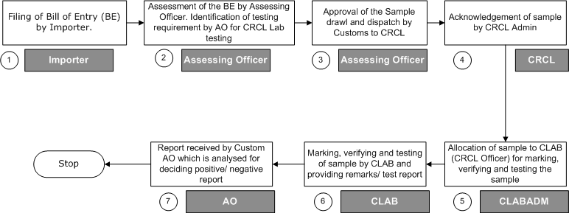
CRCL Module
Process Flow

Slide 4
CRCL Module
Functionalities
A ‘Common login’ would be provided to CRCL departmental users in ICES 1.5 application for both CRCL (Imports and Exports) modules.
The CRCL departmental users would be required to obtain SSO IDs to work in the ICES 1.5 application.
Custom Officers would choose correct ‘Lab location’ for sending a sample on basis of these directories incorporated in the system:
(a) Directory of Standing testing Instructions tariff heading wise (4 digit level);
(b) Instructions for Negative List (items which cannot be tested by CRCL labs)
This directory would be maintained centrally in New Delhi.
Post receipt of sample by CRCL labs and its acceptance, acknowledgment provided by department and content tested to verify, if the sample is adequate for testing.
(a) In case of return of test sample for any reason, old test memo already generated will be cancelled
and in case of fresh testing a new test memo would be issued. The officer drawing the sample would
be responsible for updating the remarks column, since the return of the samples would take place in
manual mode.
(b) If the sample is not considered adequate for testing, a return memo would be sent back to customs
along with reason for non acceptance. The grounds for rejection of test sample could be on
account of improper packing, insufficient quantity or non observance of other test parameters.

Slide 5
CRCL Module
Functionalities
If sample considered adequate for testing, allocation of sample to examiner done by system for respective laboratory on the basis of pendency with particular examiner.
The allocation done by nodal officer/ alternate designated officer for each laboratory. It would also assist nodal officer/ alternate designated officer for pre assignment of sample.
On completion of testing, remnants of sample sent back to Customs. Date of receipt of sample at CRCL provided in the system. Provision for ‘suspend queue’ made to indicate reasons for delay or suspension of testing for any reason.
Specific MIS reports provided to monitor pendency and performance . Indicative reports:
(a) Station wise pendency report
(b) Samples sent
(c) Sample returned list
(d) Officer wise pendency report
(e) Type of Sample
(f) Sample Rejection status
Signed copies of the test report and remainant sample, if any, will be sent as signed hard copy as well.
Post testing of the sample, the module would provide facility to enter the respective Import/ Export
Test Report in the system. Post entry of the report by the CRCL departmental user, the custom officer
at the site would interpret/ analyze the report and decide, if the report is a positive report or a negative
report.

Slide 6
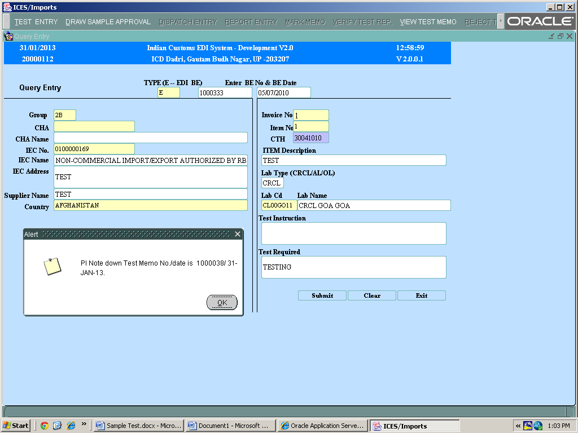
CRCL Module
BE Processing (Custom Officer)
AO may require drawl of sample of the item for test purpose. Will have to close Appraising Option & Select Option ‘Sample Test Entry’ from main menu & enter test requirements of the items and select the lab where it shall be forwarded.

Slide 7
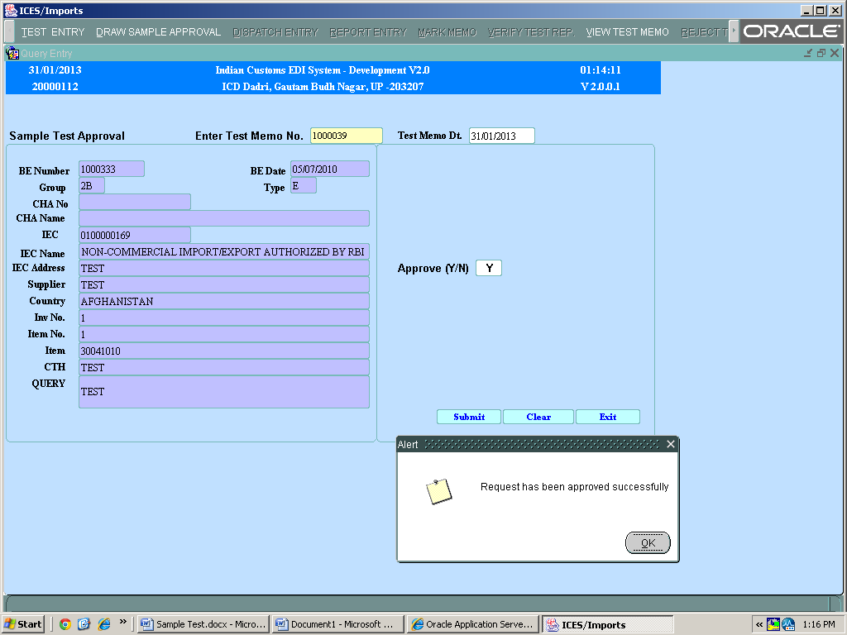
CRCL Module
Drawl Sample Approval (Custom Officer)
Approval/ Disapproval of Test requirements by AO

Slide 8
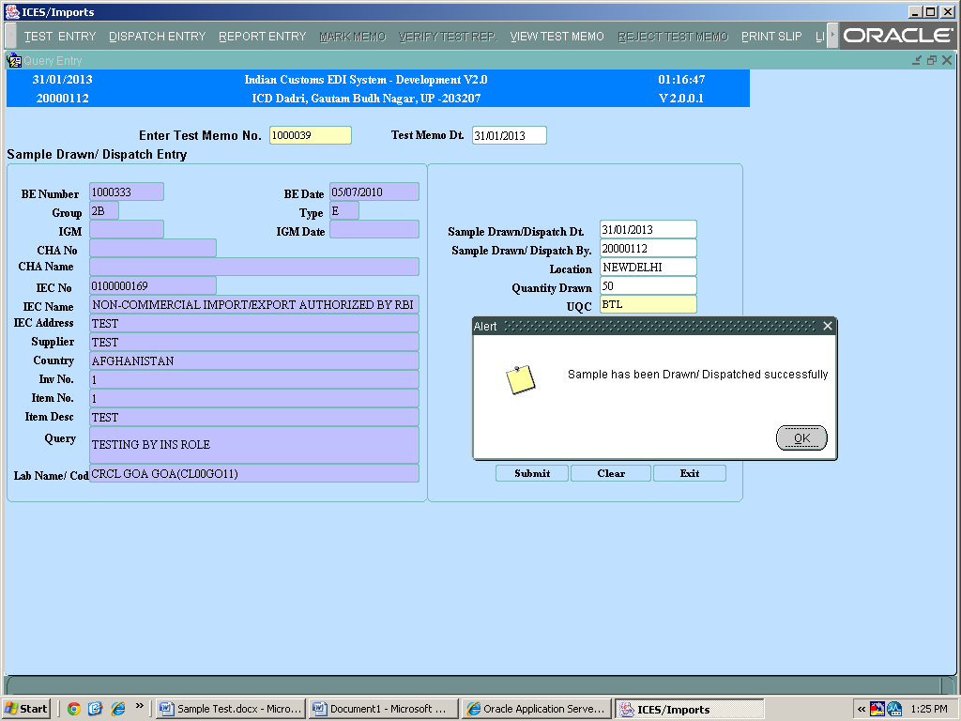
CRCL Module
Dispatch Entry
Custom Officer to draw sample and forward to the selected lab.

Slide 9
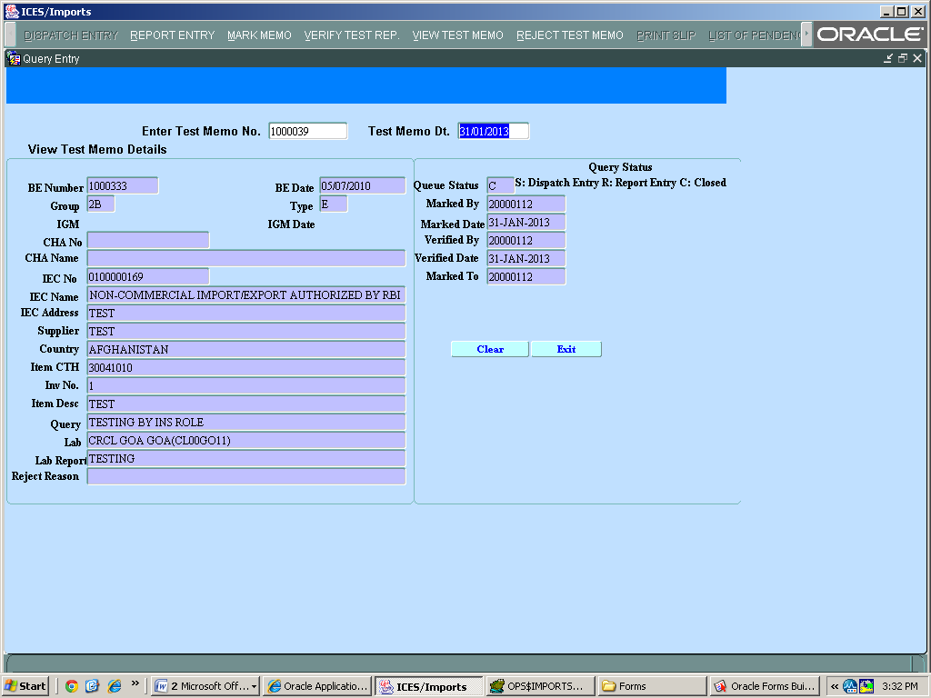
CRCL Module
View Test Memo
Option provided to all officer having Role of AO and INS (Inspector), CLAB and CLABADM.
CLAB and CLABADM users can view samples concerned to their labs.

Slide 10
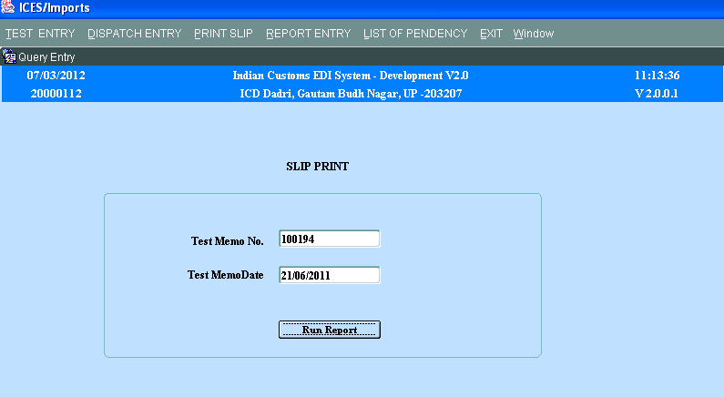
CRCL Module
Test Memo Print
Inspector can generate three copies of Test Memo to be forwarded to the Test lab.

Slide 11
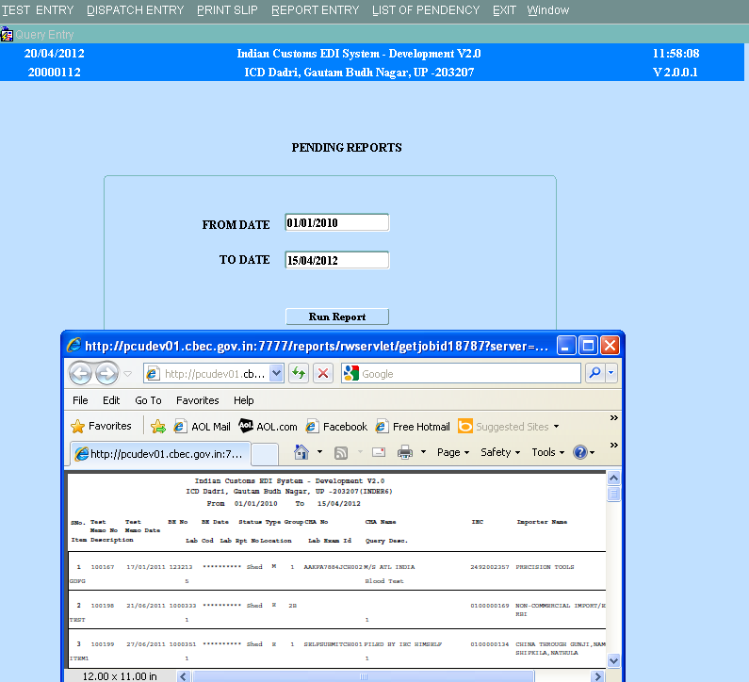
CRCL Module
List of Pendency
Customs Officers (AO and Inspectors) can generate list of Test Memos pending at different labs and queues.

Slide 12
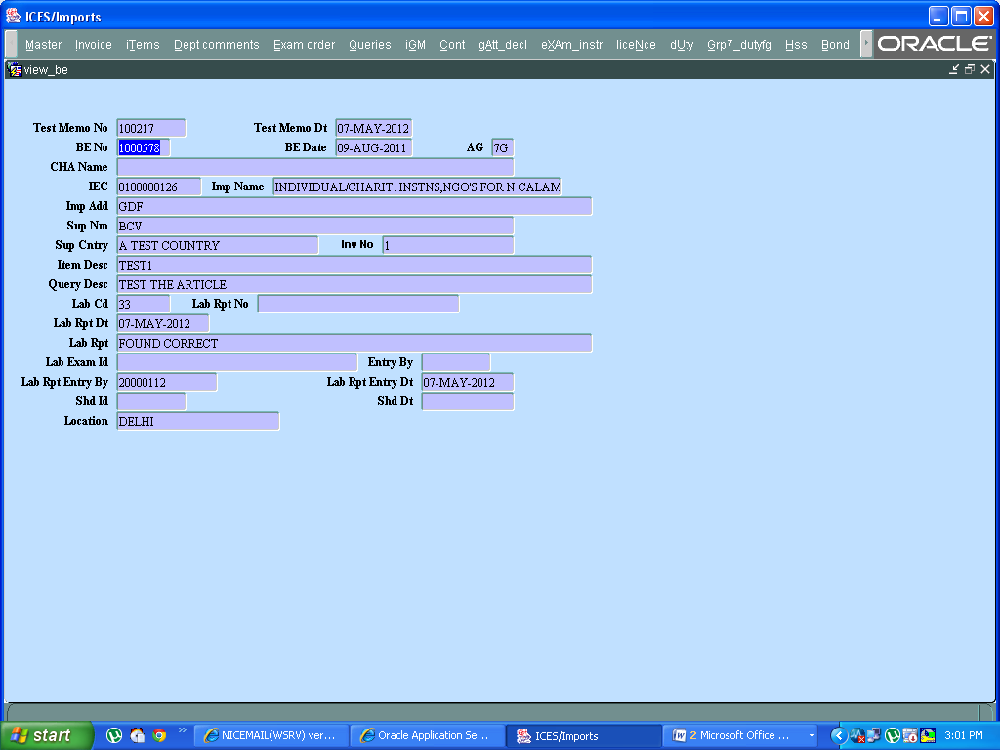
CRCL Module
View BE Option
Customs Officers can also view the Test memo reports filed or pending against the BE.

Slide 13
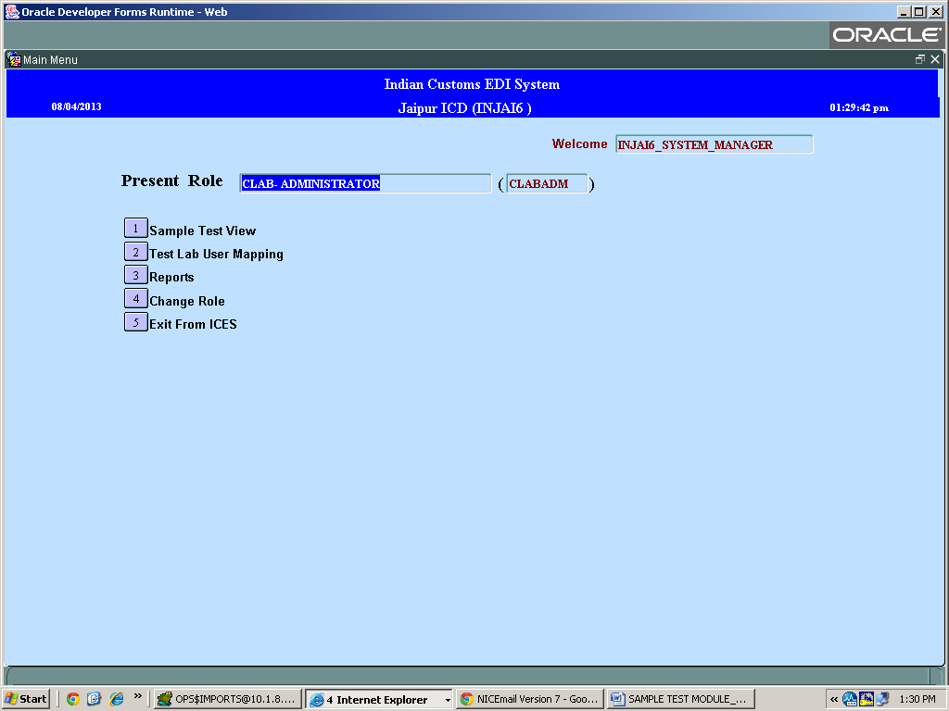
CRCL Module
Lab Administrator (CLABADM)
CLABADM role will allocate Officers of the lab with Mark and Report Entry privilege

Slide 14
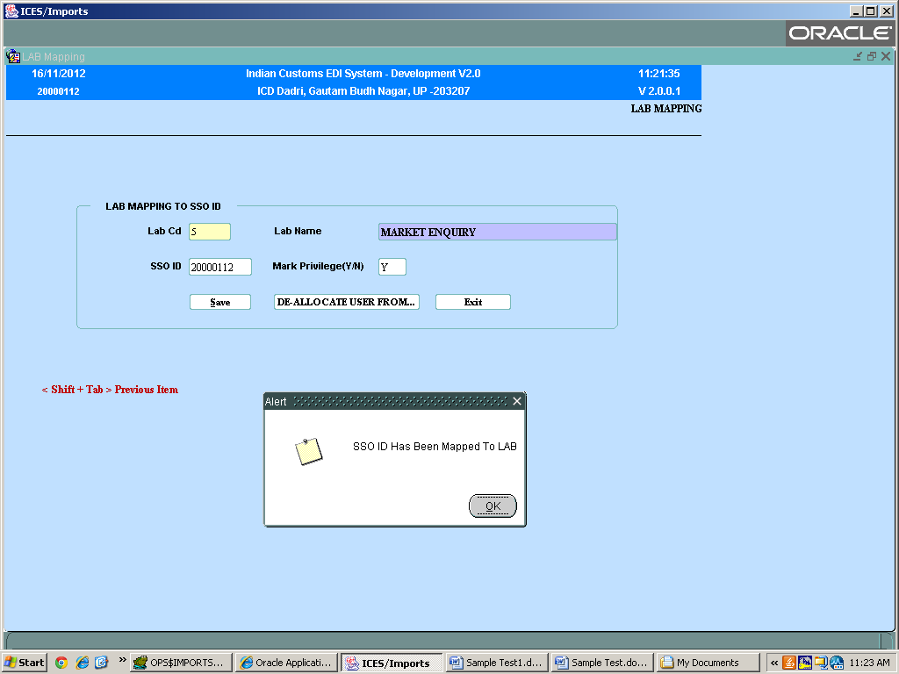
CRCL Module
Lab Administrator (CLABADM)
SSO ID mapping by CLABADM to the LAB

Slide 15
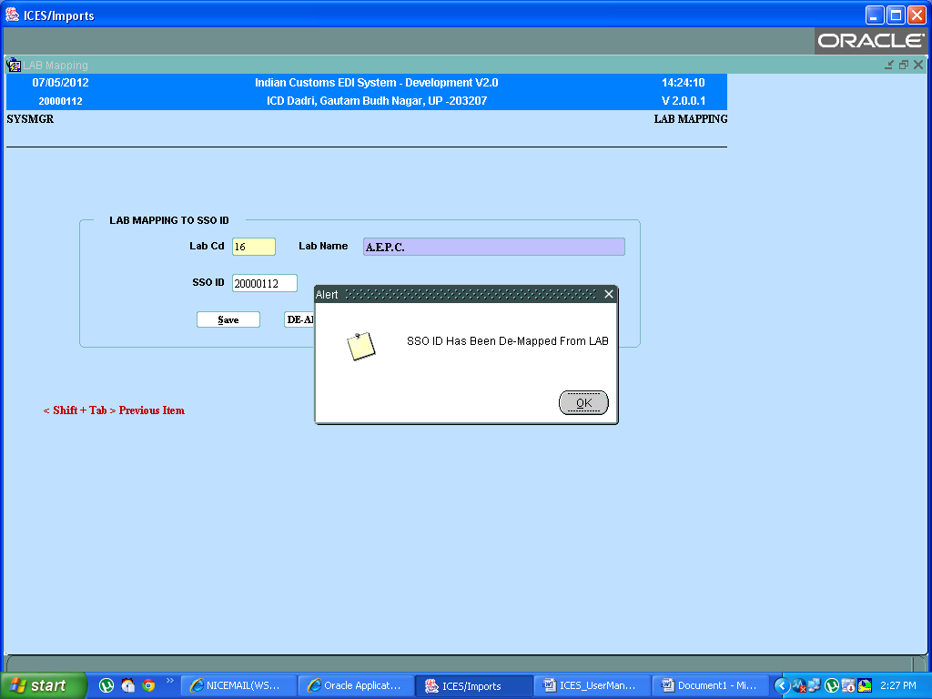
CRCL Module
Lab Administrator (CLABADM)
SSO ID mapping by CLABADM to the LAB

Slide 16
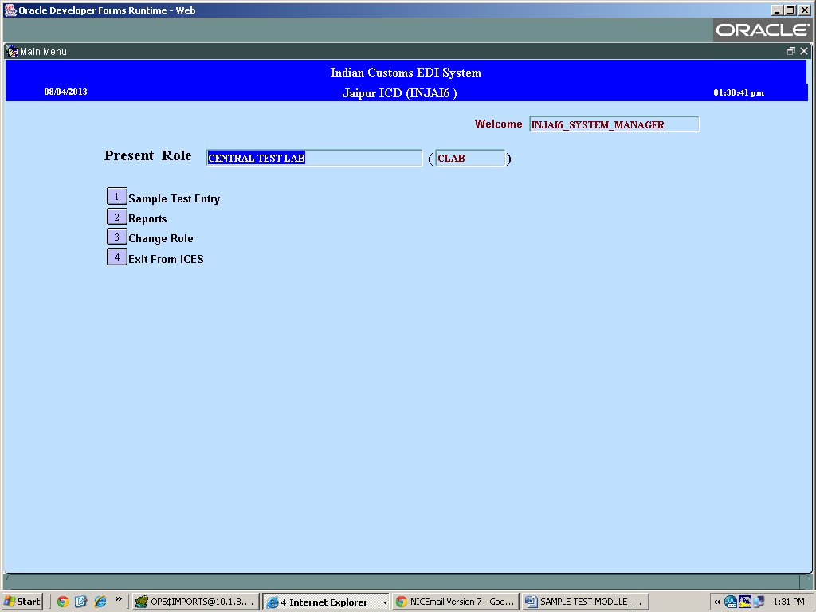
CRCL Module
Lab Officer (CLAB)
CLAB Role for marking, verification and entry of Test Report

Slide 17
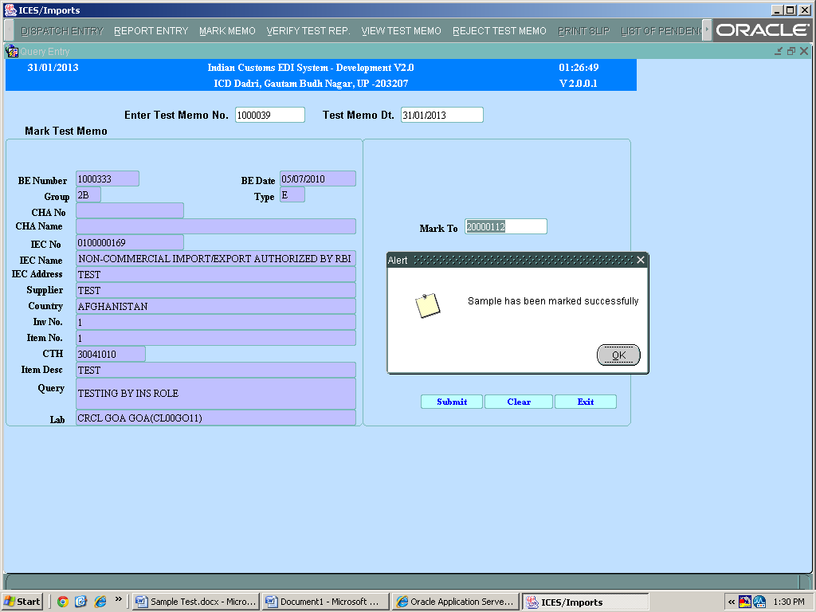
CRCL Module
Marking of Test Report
CLAB Role for marking of Test Report

Slide 18
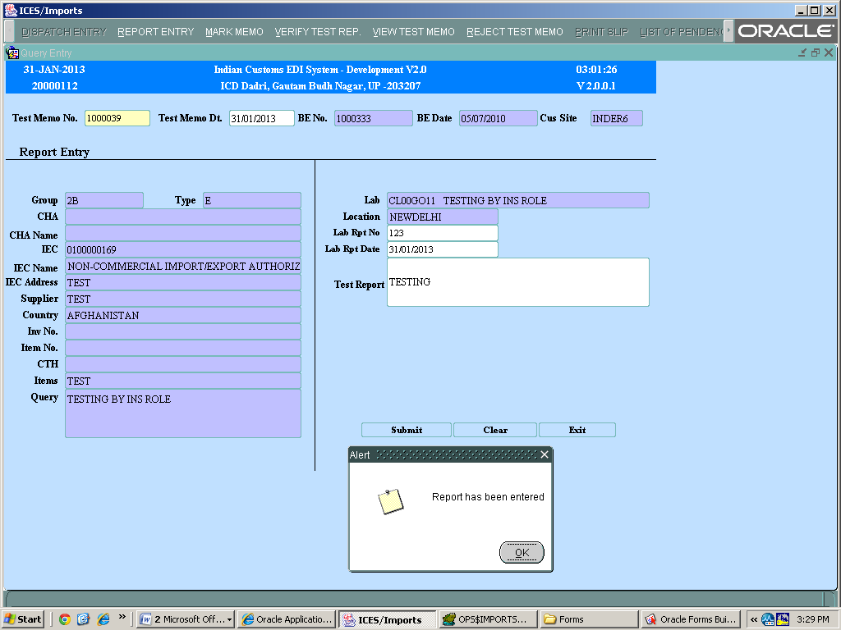
CRCL Module
Entry of Test Report
CLAB Role for entry of Test Report

Slide 19
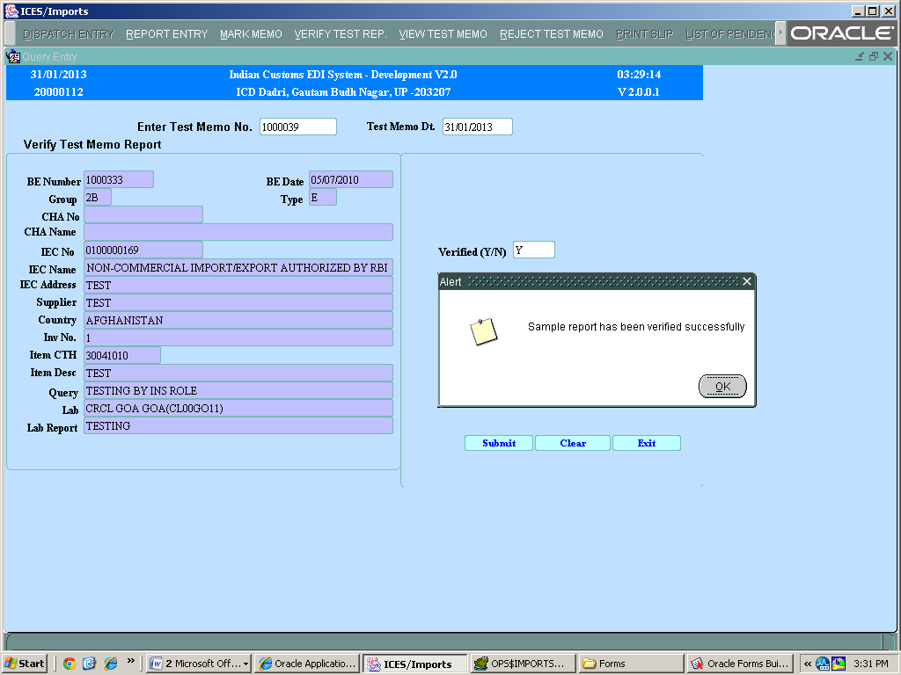
CRCL Module
Verify Test Report
CLAB Role for verifying Test Report

Slide 20
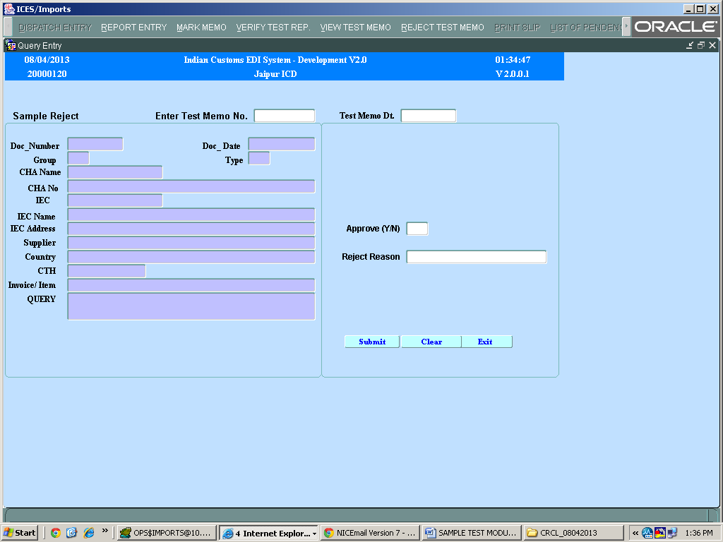
CRCL Module
Reject Test Memo
CLAB/ CLABADM Role for rejection of Test Report

Slide 21
Thank You

