Slide 1
Welcome to edi section

Slide 2
IT INITIATIVES BY CUSTOMS
ICEGATE - A gateway to Customs
Electronic Data Exchange with other Agencies
ICES - Indian Customs EDI System
RMS - Risk Management System
EDW – Enterprise Data warehouse.

Slide 3
ICEGATE – A GATEWAY TO CUSTOMS
ICEGATE - Indian Customs & Excise Gateway
ICEGATE : E – Commerce portal
www.icegate.gov.in

Slide 4
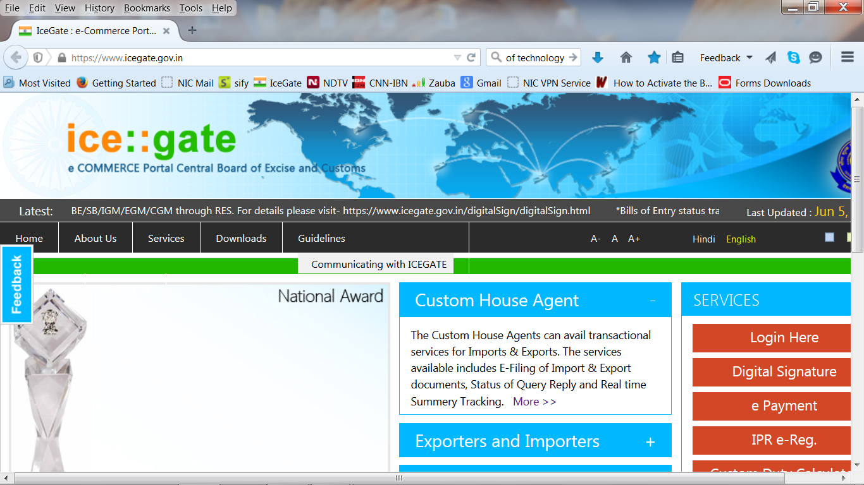

Slide 5
ICEGATE – A GATEWAY TO CUSTOMS
Remote filing of Customs Documents by Exporters, Importer and Shipping Agents.
E – Payment of Custom Duty.
Customs Duty Calculator
Exports CCRs (Compulsory Compliance Requirements)

Slide 6
ICEGATE – A GATEWAY TO CUSTOMS
Document Status
Drawback Enquiry
Digital Signature (Recent addition)
Helpdesk

Slide 7
DATA EXCHANGE WITH AGENCIES
Electronic Data Exchange with Govt. Agencies
  DGFT : IE Codes, Shipping Bill Data and Licences.
  RBI : For Foreign Exchange reconciliation
  IPA : Shipping Bills, Bill of Entry and IGM related data
  Banks : Duty Payment and Drawback disbursement
  DRI, DOV and DGCIS

Slide 8
DATA EXCHANGE WITH AGENCIES
Electronic Data Exchange with Trading Partners.
  Exporters and Importers
  Customs Brokers
  Shipping Lines and Shipping Agents
  Ports, Terminal Operators and CFS
  SEZ Bills

Slide 9
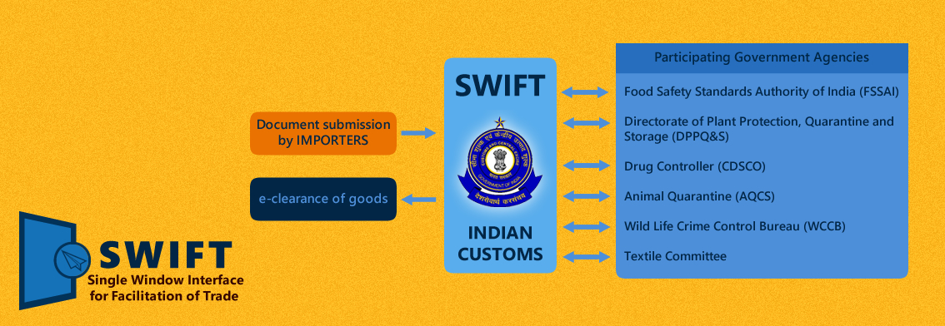
DATA EXCHANGE WITH AGENCIES
Single window interface(wef 01.04.2016)

Slide 10
Indian customs EDI System
ICES (Imports)
  Assessment
  Bond Management
  Licence Management
  Examination
  Post Clearance Audit (PCA)

Slide 11
BILL OF ENTRY PROCESSING IN ICES
IGM
ENTRY INWARDS
BE
FACILITATED
NON-FACILITATED
DUTY PAYMENT
1ST APPRAISEMENT
2ND APPRAISEMENT
GOODS REGN.
ASSESSMENT
GOODS REGN.
EXAMINATION (UPTO 100%)
DUTY PAYMENT
OUT OF CHARGE (OOC)
ASSESSMENT
GOODS REGN.
DUTY PAYMENT
EXAMINATION
(2% OR 20 PKGs )
OUT OF CHARGE (OOC)
OUT OF CHARGE (OOC)

Slide 12




SUBMISSION OF DOCUMENTS TO ICES
Service Centre
ICEGATE Server
RMS Server
ICES Server

Slide 13
PROCESSING OF BILL OF ENTRY IN ICES
Bill of Entry
Non -Facilitated Bills
Appraiser
Facilitated Bills
A.C/D.C
Bank
Examiner
A.O(Docks)
PCA - AO
PCA- AC

Slide 14
PROCESSING OF BILL OF ENTRY IN ICES
Bill of Entry
Non -Facilitated Bills
Appraiser
Checks
Notification Benefit
CTH/CETH
Unit Price
Fine/Penalty/Load
Licence Details
Bond requirements
Raise query
Examination Order
A.C/D.C
Bank
Examiner
A.O(Docks)
PCA - AO
PCA- AC

Slide 15
PROCESSING OF BILL OF ENTRY IN ICES
Bill of Entry
Non -Facilitated Bills
Appraiser
Verifies the assessment done by A.O
May send back to Appraiser or Complete assessment
A.C/D.C
Bank
Examiner
A.O(Docks)
PCA - AO
PCA- AC

Slide 16
PROCESSING OF BILL OF ENTRY IN ICES
Bill of Entry
Appraiser
A.C/D.C
Generation of Documents
1st copy of BE
TR-6 Challan
Examination Order
Bank
Examiner
A.O(Docks)
PCA - AO
PCA- AC

Slide 17
PROCESSING OF BILL OF ENTRY IN ICES
Bill of Entry
Appraiser
A.C/D.C
Duty payment
E-payment : >1.00 Lac. Bank counter: <1.00Lac
Bank
Examiner
A.O(Docks)
PCA - AO
PCA- AC

Slide 18
PROCESSING OF BILL OF ENTRY IN ICES
Bill of Entry
Appraiser
A.C/D.C
Bond Debit
IGM Regularisation for Prior Bills of Entry.
Bank
Examiner
A.O(Docks)
PCA - AO
PCA- AC

Slide 19
PROCESSING OF BILL OF ENTRY IN ICES
Bill of Entry
Appraiser
A.C/D.C
Goods Registration and Examination of Cargo.
Feeds Examination report into system.
Bank
Examiner
A.O(Docks)
PCA - AO
PCA- AC

Slide 20
PROCESSING OF BILL OF ENTRY IN ICES
Bill of Entry
Appraiser
A.C/D.C
Grants Out of Charge (OOC)
Bank
Examiner
A.O(Docks)
PCA - AO
PCA- AC

Slide 21
PROCESSING OF BILL OF ENTRY IN ICES
Bill of Entry
Appraiser
A.C/D.C
Generation of BE Copies
Importer Copy
Exchange Control Copy
Examination Report
Gate Pass
Bank
Examiner
A.O(Docks)
PCA - AO
PCA- AC

Slide 22
ROLES IN ICES (Imports)
APR - Appraiser
ACL - Asst./Dy. Commissioner
AAI - Goods Registration
INS - Examination
SUP - OOC
IGM - IGM Management
LIC - Licence Management
REB - Registration of Bonds
ACB - Asst. Commissioner (Bonds)
ACT - Asst. Commissioner (Transhipment)
IPO - Preventive Officer

Slide 23
Indian customs EDI System
ICES (Exports)
  Assessment
  Examination
  Stuffing
  EGM
  Drawback Processing

Slide 24
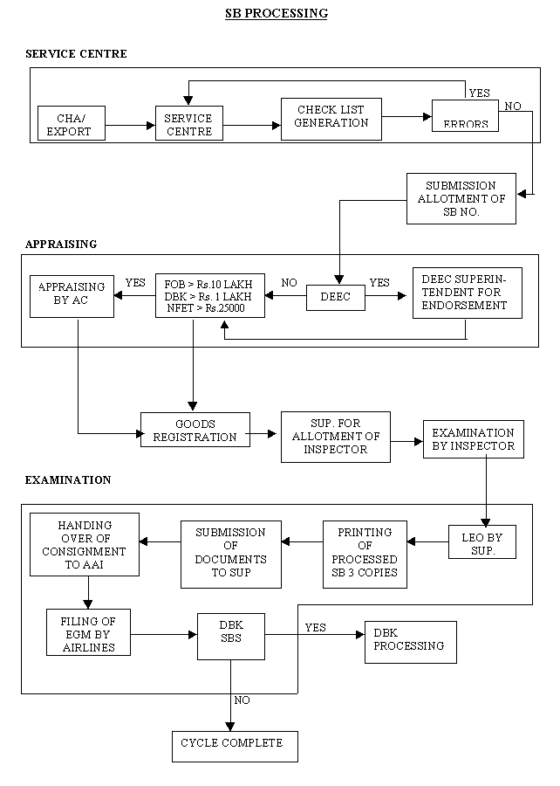

Slide 25
ROLES IN ICES (Exports)
APRS_OFF - Appraiser
AC - Asst./Dy. Commissioner
EXAM_INSP - Examiner
EXAM_SUP - Supdt./ A.O(Docks)
PREV_OFF - Preventive Officer
EGM - EGM Management
DBK_SUP - Drawback Supdt.
DBK_AC - Asst. Commissioner (Drawback)
CLK - Registration of Exporters data

Slide 26
OTHER ROLES IN ICES
MIS - Reports in Exports
STA - Reports in Imports
ADN - Imports Administration
SYSMGR - Systems Manager
ALTMGR - Alternate Systems
Manager

Slide 27
ICES 1.5 – Critical features
Single sign-on and central management of sites/users by National System Manager
National System Manager to designate the Site System Manager
Site System Manager to assign roles to User to access ICES application
Improved User Interface
Consolidation of Data for National Level MIS
Centralized Directory Management

Slide 28
Risk management system
RMS covers both Exports and Imports.
Assessment by System based on Risk Parameters.
At present 55% of documents are facilitated by RMS.
Advantages :
  Faster Clearance of Cargo for Trade
  Frees the Customs Officer from routine work

Slide 29
Problem reporting
Centralized reporting for problems in ICES
Any issue related to ICES functionality may be reported to SI Helpdesk by
  E-mail : si.helpdesk@icegate.gov.in
    Mention your SSO ID, Role, Mobile No.
    Use your icegate e-mail id.
    Attach screen shot , if available.
  Toll free no : 1800 266 2232

Slide 30
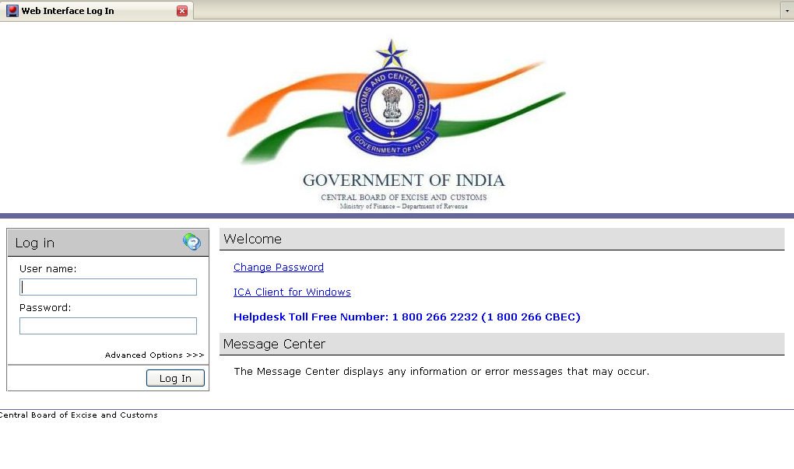
To login, type the URL http://apps.cbec.gov.in/ in the location bar of your browser.
The following screen is displayed :

Slide 31
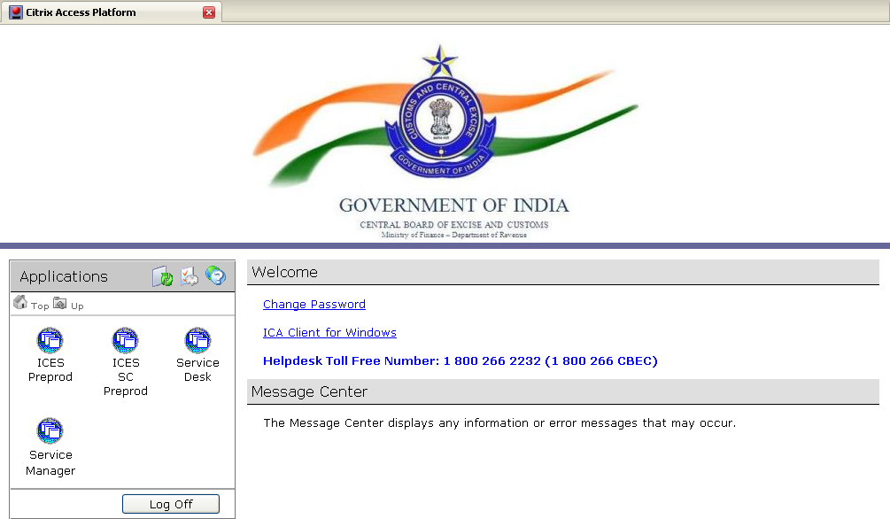
Type User ID and Password..
On submission, system authenticates the credentials and display the following screen :
The applications for which the user has authorization are displayed in the left side of the window.
To launch application, click on the ICON for the application.

Slide 32
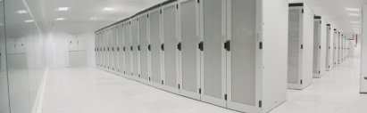


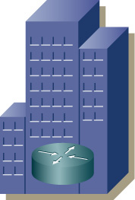
Schematic Diagram-WAN
Data Centre (DC)
Centrally Hosted Applications
ICES / ACES
INTERNET
Disastor Recovery (DR)
M P L S
Banks
Excise Range Offices
BCP
Importer / Exporter
Custodians
Central Excise
Directorates & Other Offices
Customs

Slide 33
THANK YOU

